Slide 1
HK Chu Hai College of Higher education OBOR research Institute One Belt One Road workshop series 4
Oleksandr Rogach
Chinese multinational firms in Africa: why are they so successful?

Slide 2
Chinese FDI in Africa: overview

Slide 3
China’s FDI in Africa rocketed: 2003-2021
China is still the largest investor (# 1) in Africa over the last 10 years. (USA #2, France #3).
China’s FDI stock in Africa rocketed almost a hundred-fold, from $0.5bn in 2003 to $44bn in 2020.
China committed $10bn in private FDI to Africa over the next three years ( 2022-2024).
More than 10000 Chinese MNEs invested in Africa (2021).
Chinese MNEs have an asset portfolio of US$2 trillion (2022).
China-Africa Economic and Trade Relationship Annual Report 2021 and McKinsey data

Slide 4
Chinese MNEs: sectoral distribution (in percent)

Slide 5
China's FDI in resource-rich African countries
Twelve resource-rich African countries:
75% of China's FDI by stock in 2020
South Africa, DR Congo, Zambia, Ethiopia, Angola, Nigeria, Kenya, Zimbabwe, Algeria, Ghana, Tanzania, and Mozambique.

Slide 6
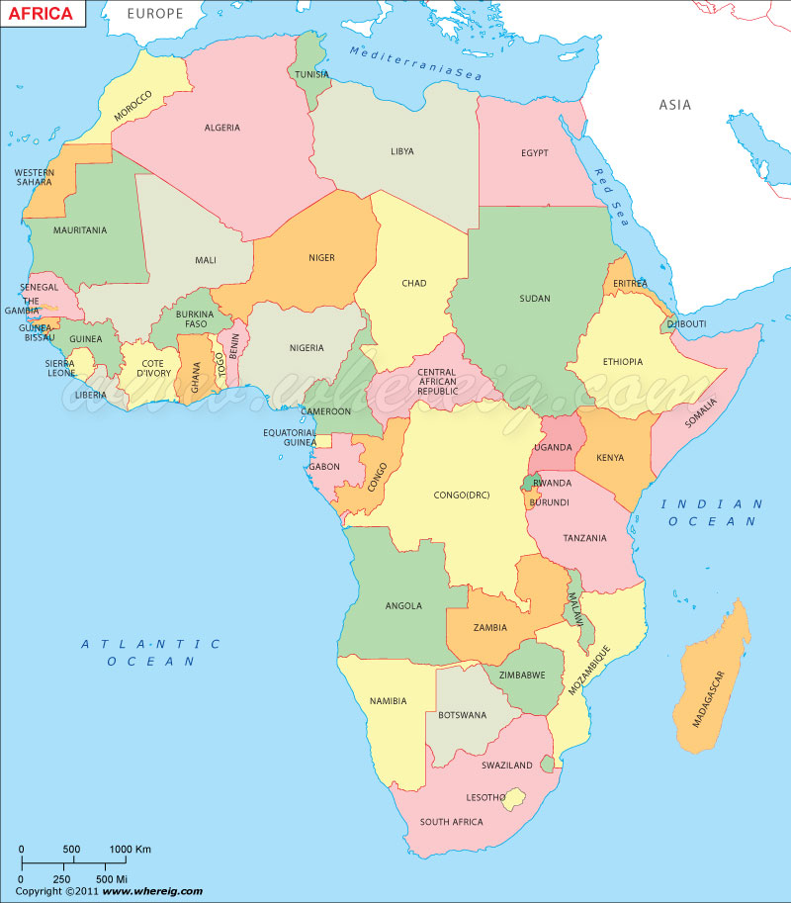

Slide 7
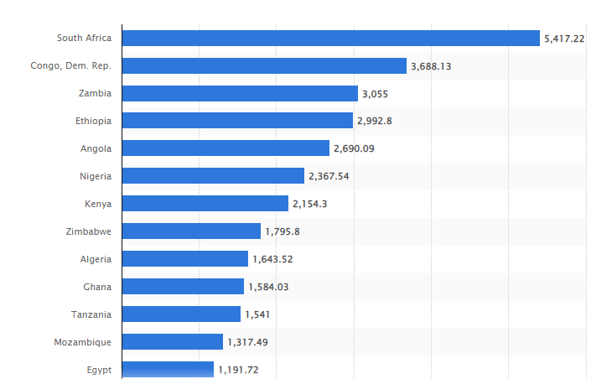
China's FDI capital stock in Africa in 2020, by country (in million U.S. dollars)

Slide 8
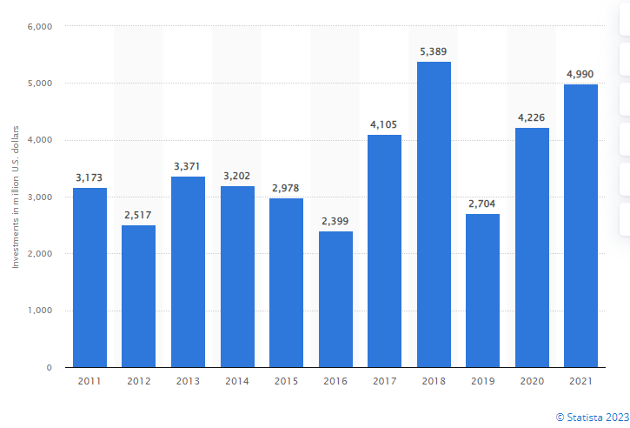
Annual flow of FDI from China to Africa from 2011 to 2021 (in million U.S. dollars)
Statistical Bulletin of China’s Outward Foreign Direct Investment

Slide 9
Chinese firm’s commitments for construction (2000-2020) in Africa
13,000-plus-km-long railways,
nearly 100,000 km of highways,
about 1,000 bridges,
nearly 100 ports,
and more than 80 large-scale power facilities.
China-Africa Economic and Trade Relationship Annual Report

Slide 10
Why are Chinese firms so successful in Africa?

Slide 11
Chinese MNEs: the reason for competitiveness
Сompetitiveness
Firm-specific advantages
Country-specific advantages

Slide 12
Chinese MNEs: Firm-specific advantages
Firm-specific assets
Firm-specific strategy

Slide 13
Chinese MNEs: Firm-specific assets (FSA)
Traditional FSA
Economy of scale advantages;
Low cost advantages;
Access to cheap financial resources.
New FSA:
Cutting edge innovations;
Unique experience in the large-scale projects;
Differentiation of services and products.

Slide 14
The scale advantage of Chinese firms
It lowers unit production costs.
It facilitates agglomeration benefits.
It increases the bargaining power of Chinese firms.
Cost leadership strategy are the typical for most Chinese MNEs in Africa

Slide 15
Chinese MNEs: financial advantages for internationalization
Chinese FDI is driven by relatively easy access to cheap capital
preferential access to capital,
and low interest financing granted by Chinese banks.
Easy access to financing provides Chinese players with a significant advantage over competitors.

Slide 16
The country-specific advantage of Chinese MNEs
Chinese MNEs are able to take full advantage of China:
growing and very large market,
a large and growing production platform,
fierce competition at home,
special governmental incentives.

Slide 17
Chinese MNEs: Firm-specific strategy
Why have Chinese firms developed a particular strategy in Africa?

Slide 18
High “psychic distance” of Chinese MNEs and African partners
Language differences;
Differences in business behavior patterns;
Differences in business ethics;
Cultural barriers/cultural distance….. etc.

Slide 19
Chinese MNEs: Firm-specific strategy
Flexibility;
Adaptation to local conditions;
Networking with local partners;
Designing unique human resources relationships.

Slide 20
Entry modes with ‘‘Chinese characteristics’’: ownership
Chinese MNE aims at minority stakes in African enterprises (less than 50% or 50%).
Benefits for Chines firms and for local participants.

Slide 21
1. Alliances: Chinese way to overcome the “psychic distance”
Chinese MNEs acquire ‘‘network knowledge’’.
They typically rely on alliances with partners, export intermediaries and government agencies to compensate for knowledge shortages.
They used connections with the Chinese diaspora to set alliances.

Slide 22
2. Clustering: Chinese MNEs in trade zones
China has created 25 economic and trade cooperation zones in 16 African countries.
The zones had attracted 623 businesses with a total investment of $7.35bn at the end of 2020.
China-Africa Economic and Trade Relationship Annual Report 2021.

Slide 23
3. Networking with local institutions
To learn and apply local traditional norms and practices.
To understand needs of local communities and consumers.
To give better respond to some of the demands of African partners in local, state, and central government posts.

