Slide 1
One Belt One Road Workshop Series 4: Chinese Firm in Madagascar: King Deer Cashmere Co.
TANG HUI March 30, 2023

Slide 2
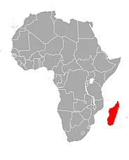
contents
1 Overview of Madagascar, Madagascar FDI Advantages and Risks
2 World FDI flows to Madagascar
3 China FDI to Madagascar
4 Chinese Company in Madagascar
5 FDI hypothesis
Madagascar

Slide 3
1 Overview of Madagascar
Area: about 59,000sq km
Location: in the southeast sea of the African continent
Population: 28 million (in year 2022)
Capital: Tananarive
Language: French, Malagasy
Climate: tropical rainforest climate (east), savanna climate (west)
Economy: 24.1%--13.3%--57%

Slide 4
Natural resources are abundant
Graphite reserves account for the first in Africa
Vanilla production and export volume are the world's first
The river and forest resources
Food crops are rice
Tourism resources

Slide 5
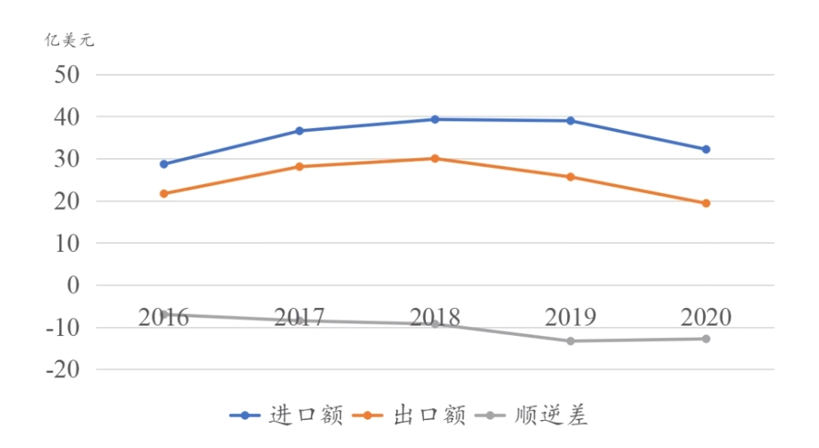
1 Madagascar FDI Advantages and Risks
Madagascar’s mainly exports: vanilla and minerals
Madagascar’s mainly import: oil, light oil and rice, wheat, flour
(100 million US $)
Import
Export
Surplus and deficit

Slide 6
1 Madagascar FDI Advantages and Risks
FDI Advantages
Rich natural resources
Low wage costs
Relatively sound policies and regulations
Simple procedures for establishing a company

Slide 7
FDI Industry incentive policies
1) Tourism, minerals, mining
2) Marine fishing and freshwater farming
3) Textile and garment processing and export industries
And also : handicrafts, agriculture
information and communication technology
infrastructure construction

Slide 8
2 World FDI Flows to Madagascar

Slide 9
3 China FDI to Madagascar
51 years: In 1972 China and Madagascar established diplomatic relations
6 years: In 2017 the presidents of the two countries signed the MOU jointly promoting the Belt and Road initiative

Slide 10
3 China FDI to Madagascar

Slide 11
3 China FDI to Madagascar
China FDI in fields of Madagascar:
(use a pie chart to express the proportion of FDI fields，but I cannot find the exact data)
Mineral development
Textile industry
Public works
Oil development
Agriculture
Hydraulic engineering

Slide 12
Chinese companies and population in Madagascar
128? Chinese companies in Madagascar (in 2021)
60000 overseas Chinese and ethic Chinese (in 2021)

Slide 13
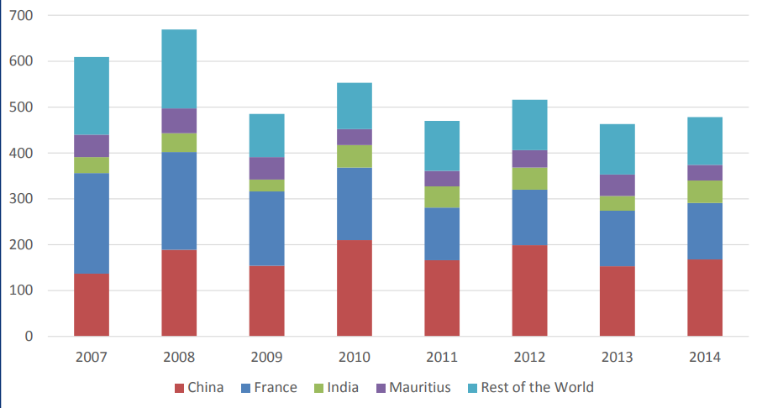
Number of newly registered foreign firms in Madagascar, by origin (2007-2014)

Slide 14
Proportion of newly registered firms, by origin (2007-2014)

Slide 15
Wuhan Iron & Steel Company (WISCO) in Madagascar
in 2010, investment by Wuhan Iron & Steel Company (WISCO) completely changed the picture of the Malagasy mining sector.
That year, the company paid US$100 million for exploration permits in the Soalala region.
WISCO stated explorations in 2011, and the project is projected to be the largest mining endeavor in Malagasy history

Slide 16
Chinese firms in the farming of Seafood
SOMAQUA and Longfei operate in Mahajanga on the northern coast of the island.
Both firms primarily operate as exporters of fish and seafood bought from local sources.
They have also invested in establishing facilities and plants for the farming of seafood for export.

Slide 17
Cement and construction materials
One of the larger and most established Chinese firms operating in Madagascar works in the cement and construction sector.
Maloci is a Chinese-owned cement production enterprise.
The firm is also involved in export and import of aquaculture products, minerals, and construction equipment.

Slide 18
4 Chinese Company in Madagascar—Inner Mongolia King Deer Cashmere Co., Ltd
Founded in 1985
Products sell well in more than 30 countries
Annual sales revenue of 1 billion RMB yuan
Ownes more than 10000 employees
3 manufacturing plants: Baotou in China, Madagascar in Africa, Cambodia in Asia
http://www.kingdeer.com.cn/dept_info/reso_dept/english/gsjs/jpz/38104.shtml; https://www.facebook.com/kdc.philipperandria.mg/

Slide 19
King deer Cashmere Co. Business negotiations
http://www.kingdeer.com.cn/dept_info/reso_dept/english/gsjs/jpz/38104.shtml; https://www.facebook.com/kdc.philipperandria.mg/

Slide 20
Madagascar King Deer Cashmere Co. Ltd
Established in 1997
It is once to be the biggest enterprise in Madagascar
Providing 20 % of its employment for Madagascar

Slide 21
Madagascar King Deer ( MKD)
http://www.kingdeer.com.cn/dept_info/reso_dept/english/gsjs/jpz/38104.shtml; https://www.facebook.com/kdc.philipperandria.mg/

Slide 22
MKD: capital and production
Registered capital: $586,921
Business scope: cashmere knitgoods
Throughput: 1.5 million piece cashmere sweater

Slide 23
MKD: Production equipment
King Deer (Hong Kong) Co., Ltd and King Deer Shangdu Branch Company supplied:
computer flat knitting machine,
linking machine,
milling machine,
drying machine,
finishing and Ironing machine.

Slide 24
http://www.kingdeer.com.cn/dept_info/reso_dept/english/gsjs/jpz/38104.shtml; https://www.facebook.com/kdc.philipperandria.mg/

Slide 25
http://www.kingdeer.com.cn/dept_info/reso_dept/english/gsjs/jpz/38104.shtml; https://www.facebook.com/kdc.philipperandria.mg/

Slide 26
MKD: Employment and Training (1)
Owning more than 6,000 employees
Training local technical and professional personnel , trained more than 100,000 textile workers in more than 20 years
http://www.kingdeer.com.cn/dept_info/reso_dept/english/gsjs/jpz/38104.shtml; https://www.facebook.com/kdc.philipperandria.mg/

Slide 27
MKD: Employment and Training (2)
At MKD, new workers are subject to a of in-house training.
Formal training requires up to three months, and workers generally require a year to become fully proficient with the equipment.
As such, they have had a high rate of staff retention, and most of the staff are permanently employed.
KDC is the largest employer of Malagasy workers.
http://www.kingdeer.com.cn/dept_info/reso_dept/english/gsjs/jpz/38104.shtml; https://www.facebook.com/kdc.philipperandria.mg/

Slide 28
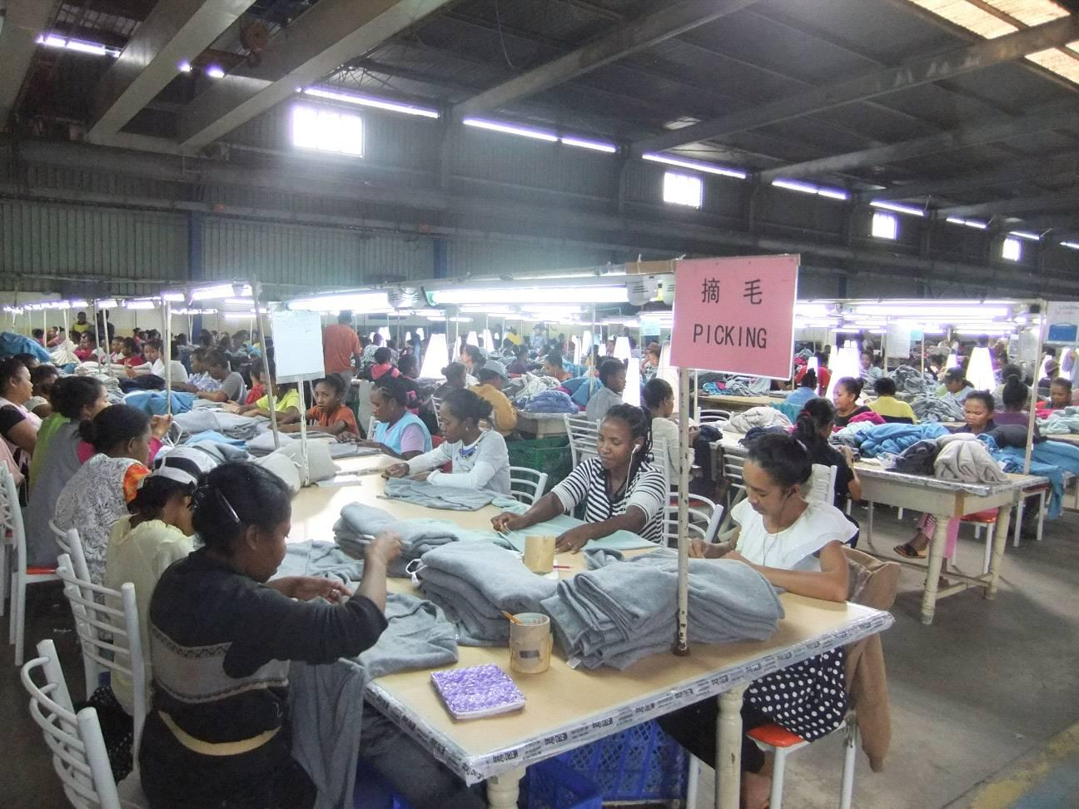
MKD: Employment and Training
http://www.kingdeer.com.cn/dept_info/reso_dept/english/gsjs/jpz/38104.shtml; https://www.facebook.com/kdc.philipperandria.mg/

Slide 29
MKD: promoting cultural ties Madagascar - China
Madagascar King Deer is the first overseas company to promote Chinese language and spread Chinese culture
The company teach staff to study Chinese characters and impart Chinese culture
Madagascar King Deer uses cultural ties to develop and spread textile technology in Madagascar

Slide 30
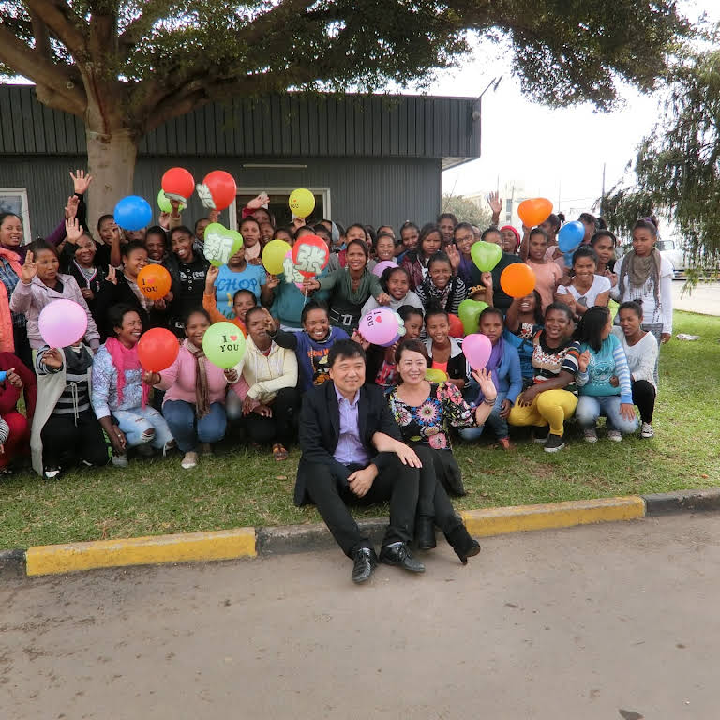
MKD: promoting cultural ties Madagascar- China
http://www.kingdeer.com.cn/dept_info/reso_dept/english/gsjs/jpz/38104.shtml; https://www.facebook.com/kdc.philipperandria.mg/

Slide 31
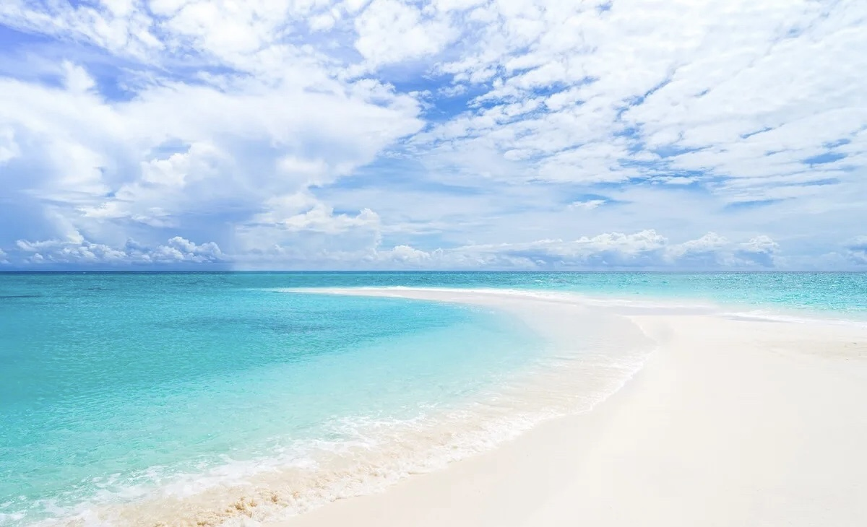
5 Proposals for the Chinese FDI projects development in Madagascar
If a Chinese company wants to invest travel in Madagascar, it can do the following:
In China:
1 Produce landscape films of Madagascar
2 Promote through various channels
3 Set up exclusive international flights

Slide 32
5 Proposals for the Chinese FDI projects development in Madagascar
In Madagascar:
1 Set up a travel company and get the right to operate
2 Seek the cooperation with some 4-star or 5-star hotels or build a new hotel
3 Seek the cooperation with famous sceneries and can even develop new secenery

Slide 33
Thank you for watching!

