Slide 1
Chinese FDI in Nigeria: Case study of CGCOC Group
One Belt One Road Workshop Series 4:
China Foreign Direct Investment in Africa
Institute: One Belt One Road Research Institute
Speaker: Zhang Shimin

Slide 2
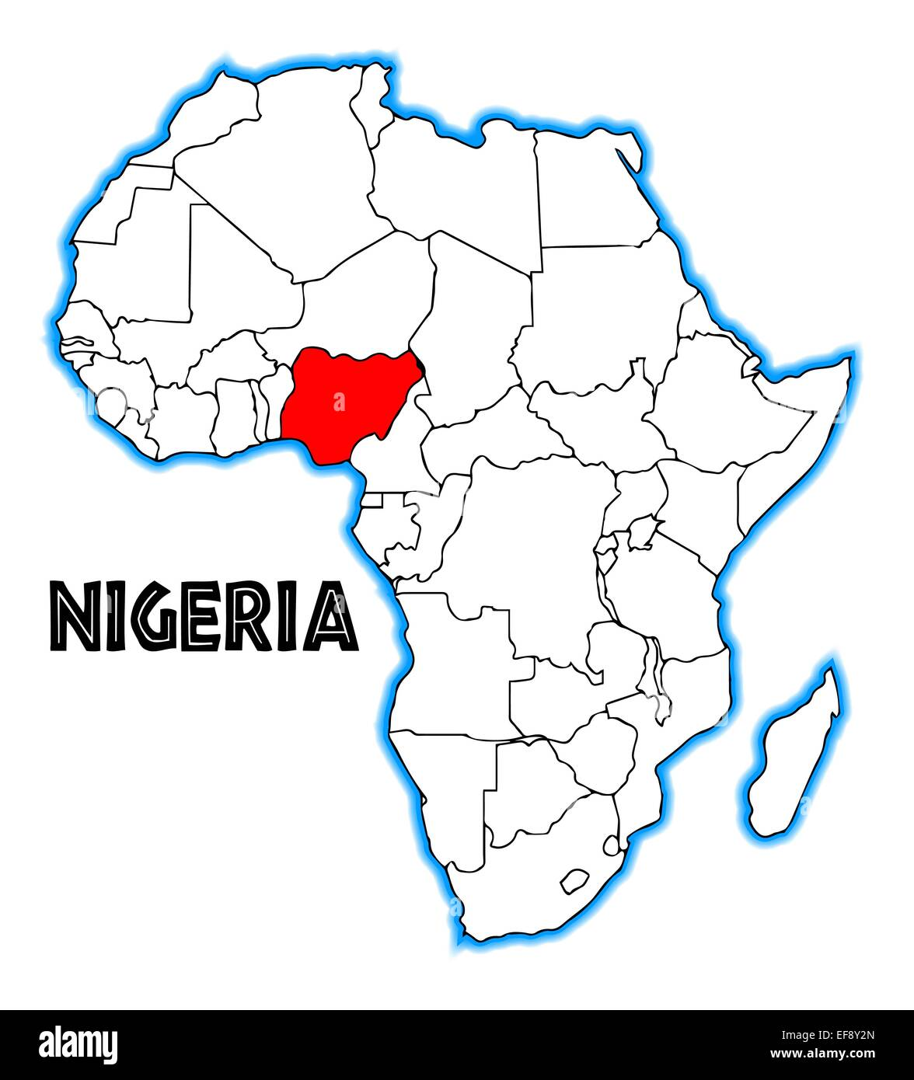
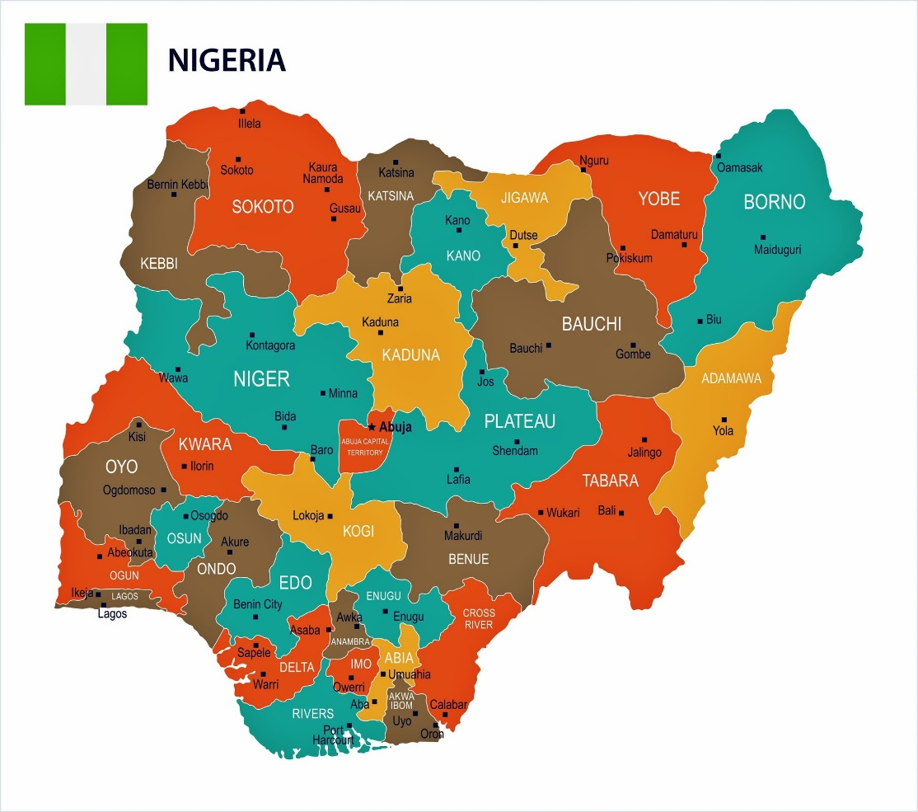

Slide 3
Nigeria is the most populous country in Africa.
The population of Nigeria reached at 216.75 million in 2022.
Population
Nigeria is the most ethnically diverse country in the world with over 250 ethnic groups.
Ethnic Group

Slide 4
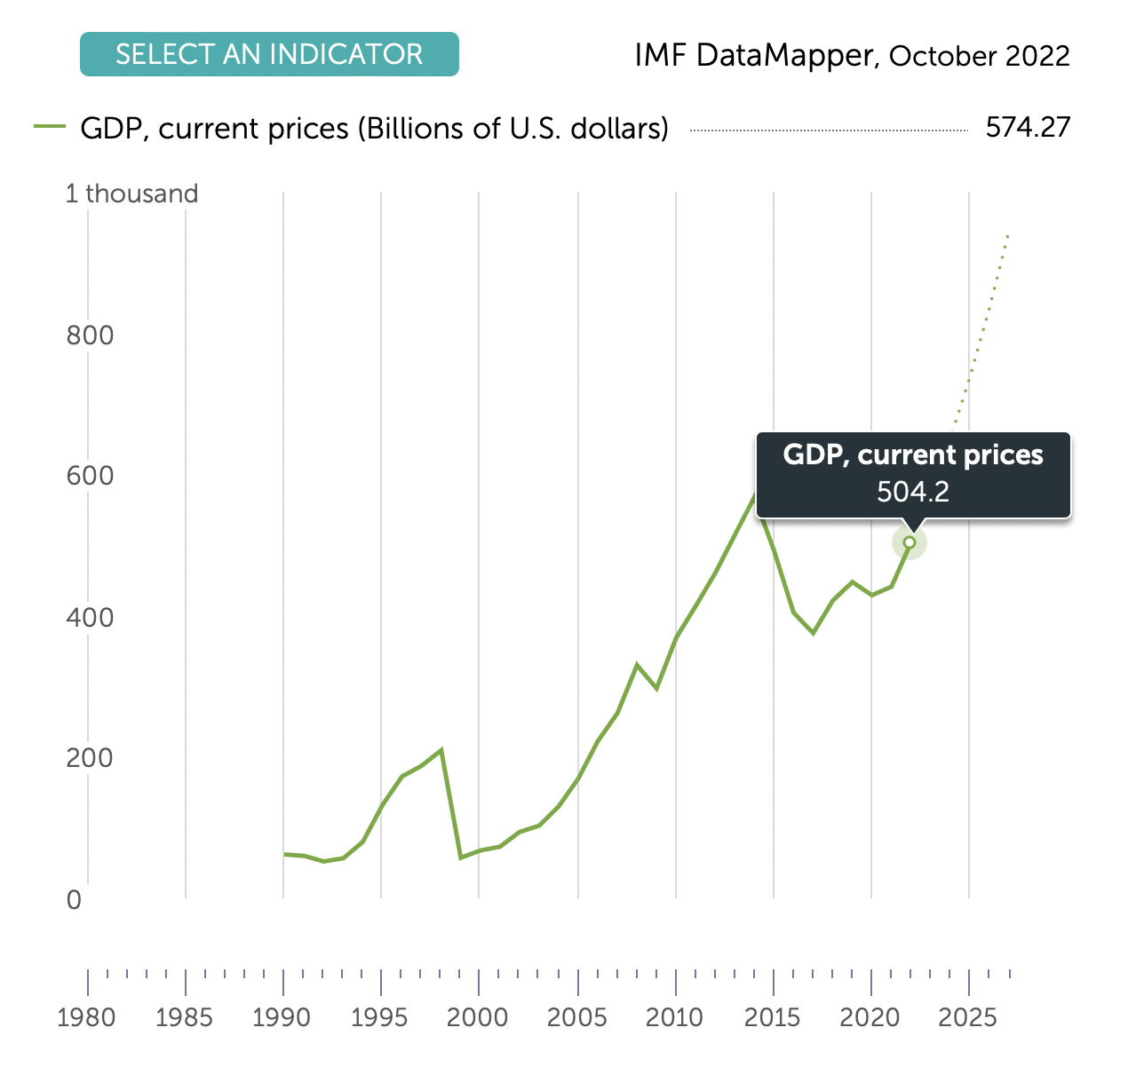
Economic
Nigeria has the largest economy in Africa.

Slide 5
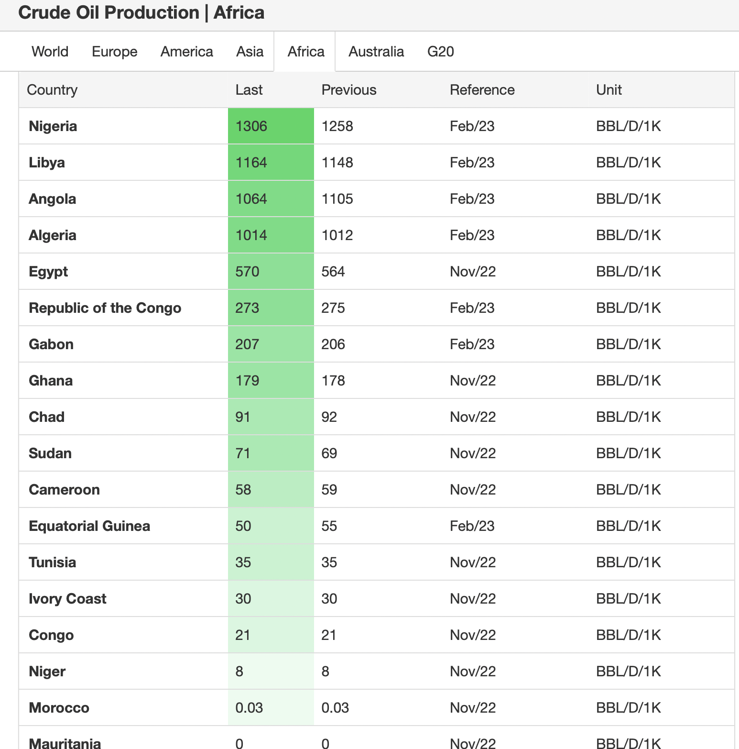
Energy
Nigeria is the largest crude oil production country in Africa.
Data Sources: Trading Economices

Slide 6
Relation between China and Nigeria

Slide 7
Main Events Between China and Nigeria
1971, Established diplomatic relations
2006, Established a strategic partnership
2018, Join the Belt and Road Initiative

Slide 8
Data Sources: National Bureau of Statistics

Slide 9
Nigeria is China's :
Largest project contracting market in Africa
1
Second largest trading partner in Africa
2
Major investment destination
3

Slide 10
Data Sources: National Bureau of Statistics

Slide 11
Chinese Investment in Nigeria
Main industries
Construction, Mining, Manufacturing, Finance, Leasing and Business Services
Main companies
More than 1,000 Chinese companies in Nigeria. Like China Civil Engineering Construction Corporation, CGCOC Group, HUAWEI, ZTE, Lee’s Group, etc.

Slide 12
Selected Chinese firm’s projects in Nigeria

Slide 13
Cases of Chinese FDI in Nigeria

Slide 14
CGCOC Group Co., Ltd.
Founded in 1983
Business field：Consulting planning, investment operation, overseas infrastructure construction, logistics and trade.
Mixed-ownership enterprise jointly funded by state-owned enterprises, management teams, local state-owned assets as well as overseas key employees and external natural persons.

Slide 15
CGCOC in Africa
Formed three regional centers in Africa, namely the eastern Africa, west-central Africa with English speaking regions and French speaking regions.
Overing 27 countries and accounting for 50% of the whole African countries.
The employees of CGCOC have reached to nearly 25,000 at home and abroad, among them, over 90% are foreign nationals.

Slide 16
CGCOC in Africa: organization and structure

Slide 17
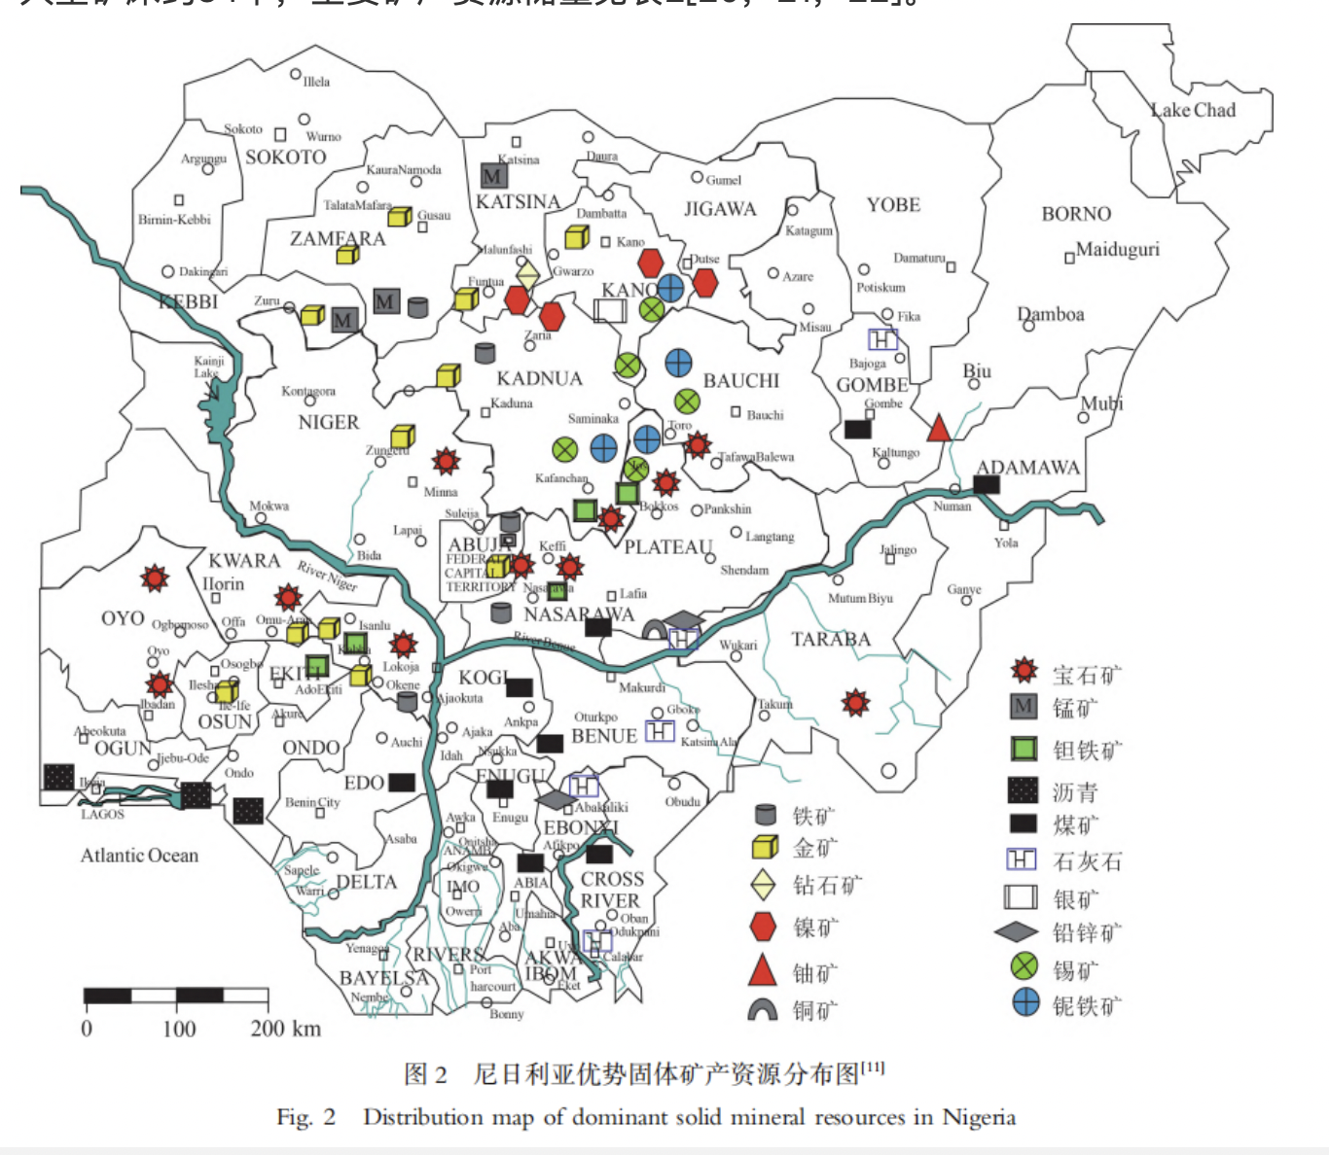
CGCOC Group - Mining
。
CGCOC have been granted about 60 prospecting and mining rights, including niobium, tantalum, lead, zinc, copper, tungsten, tin and coal mines.
Meanwhile, in order to quickly achieve prospecting breakthrough, CGCOC established a rock and mineral analysis laboratory in Nigeria.

Slide 18
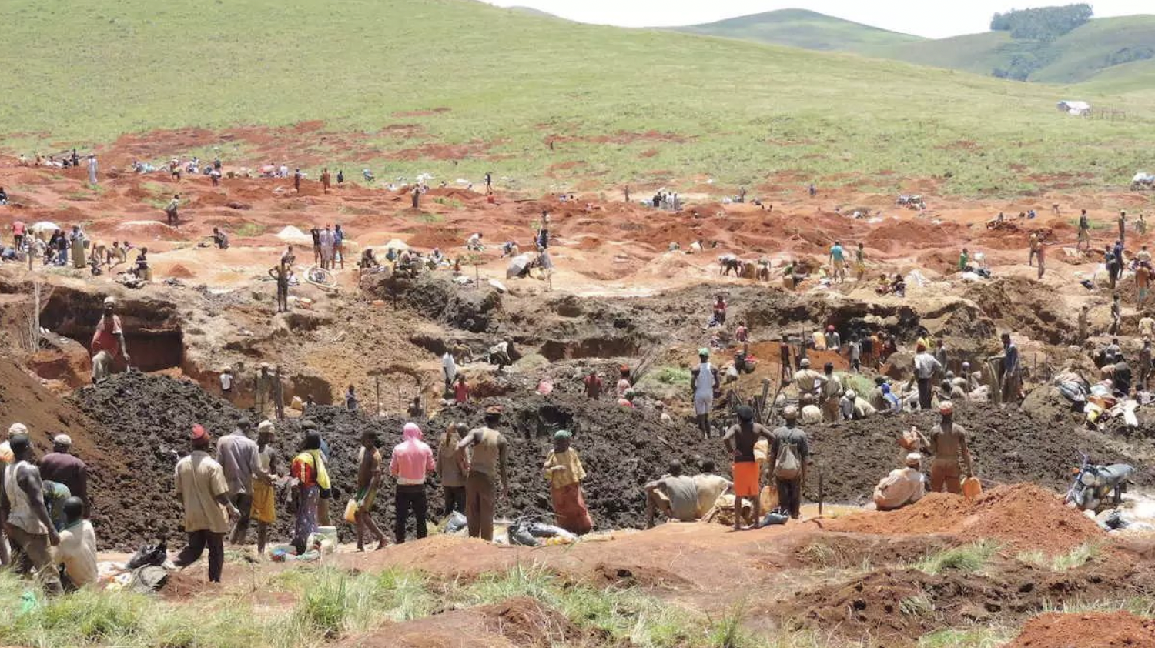
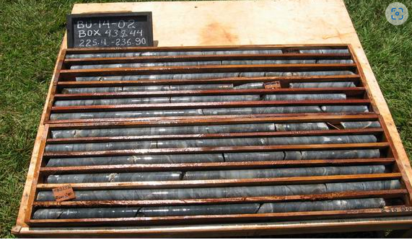
Investment advice for mineral resources in Nigeria
Priority can be given to the development of precious and rare metals.
Nigeria produces more refined tin than it needs, which is perfectly complementary to China.
98% of Nigeria's niobium tantalum ore is exported to China, and the prices of niobium, tantalum and other rare metals are relatively stable.

Slide 19
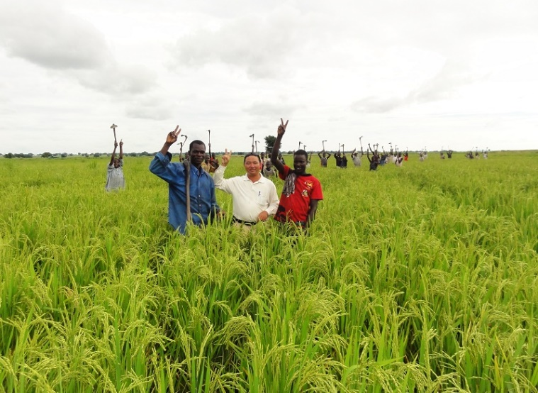
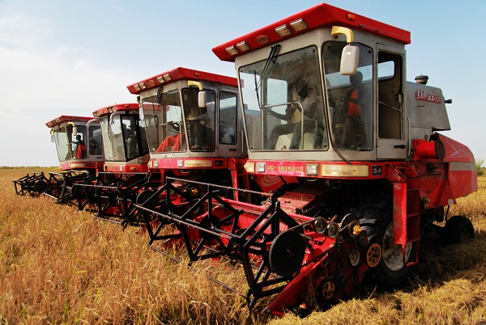
CGCOC Group : Nigeria WARA Agricultural Park (1)
Set up Green Agricultural Development Nigeria CO., Limited in 2006.
The farm is located in northwestern Nigeria, right next to the Kanji reservoir, the biggest one in the Niger River in West Africa.

Slide 20
CGCOC Group : Nigeria WARA Agricultural Park (2)
Signed cooperation agreement with Yuan Long Ping High-Tech Agriculture CO., Ltd. (LPHT) in 2008.
CGCOC Group accounted for 87.5% of the shares; LPHT accounted for 12.5% of shares.
The crop breeds, sophisticatedly cultivated by the farming techniques adapted to the local environment, have occupied a significant share of Nigeria's agricultural markets.
An important link in the Nigerian agricultural production chain.

Slide 21
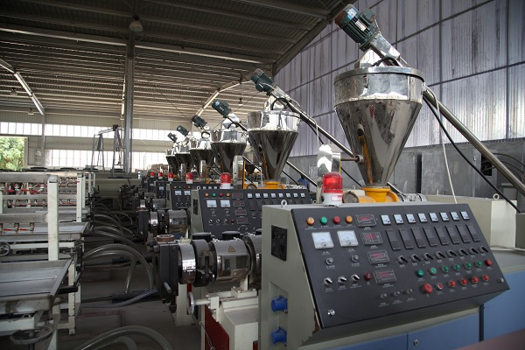
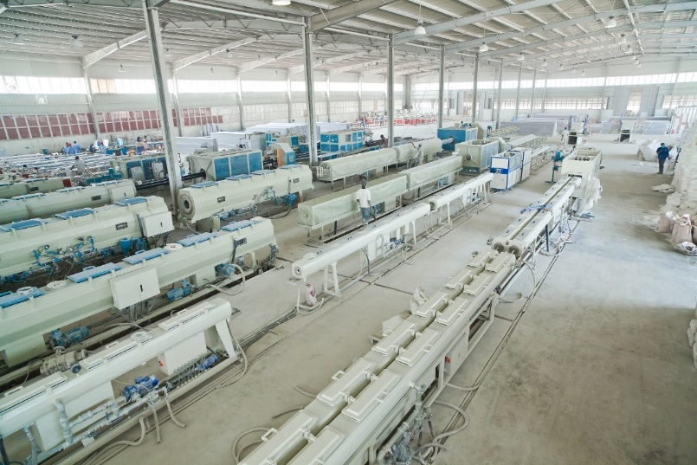
CGCOC Group: Nigeria SINCEERPVC tube plant
The main products are assorted water supply and drainage PVC pipes, pipe fittings and other products.
Because of the good quality and reasonable price, the products are well received in the market.

Slide 22
CGCOC Group: Mambilla hydropower plant
Known as the “Sanxia Project” in Nigeria.
Will be Nigeria’s biggest power plant, producing approximately 4.7 billion kWh of electricity a year，equivalent to 70% of Nigeria's existing electricity generation.
The project is estimated to cost $5.8bn.Invested by Gezhouba Group,SINOHYDRO Corporation Limited, and CGCOC Group, which occupied 45%，35%，20% respectively.
Will generate up to 50,000 local jobs during the construction phase.

Slide 23
CGCOC Group: Social responsibility in Africa
2009- 2018 China's leading enterprise in social responsibility of foreign contracted projects.
2009- 2018 Social responsibility excellence award.
2005- present China foreign contractors association AAA credit enterprise

